Slide 1


Session // 03B Physics Informed NEURAL NETWORKS FACULTY OF SCIENCE AND ENGINEERING +++
Diego Corona Lopez – AI Technical Specialist

Slide 2
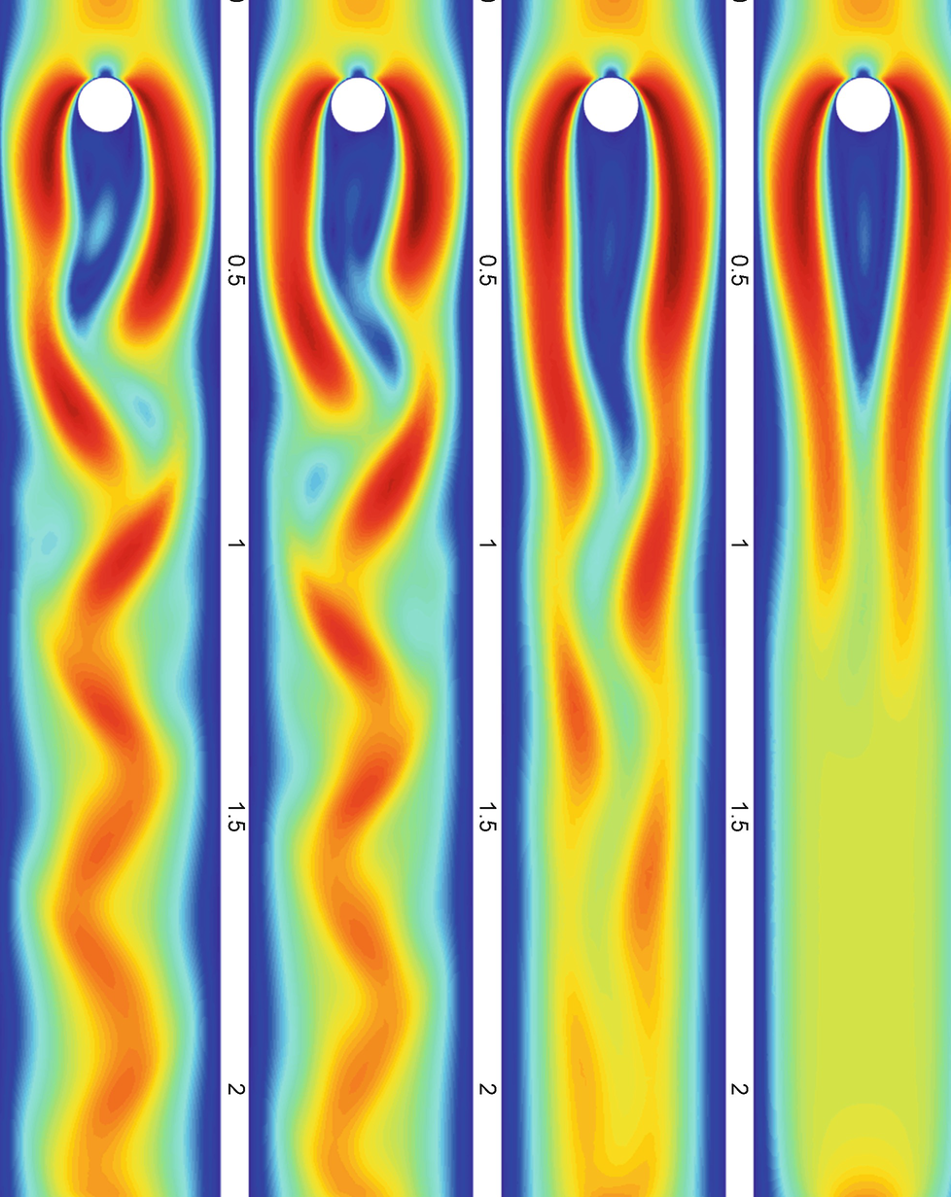
Agenda
Introduction to Physics-Informed Neural Networks
Navier-Stokes Equations and Fluid Flow
Mathematical formulation of Navier-Stokes equations
Momentum and continuity equations
PINN Architecture and Components
Loss Functions and Physics Constraints
Computing derivatives via autograd
First and second order derivatives implementation
Residual formulation for Navier-Stokes equations
Training Process and Optimization
Results and Visualization

Slide 3
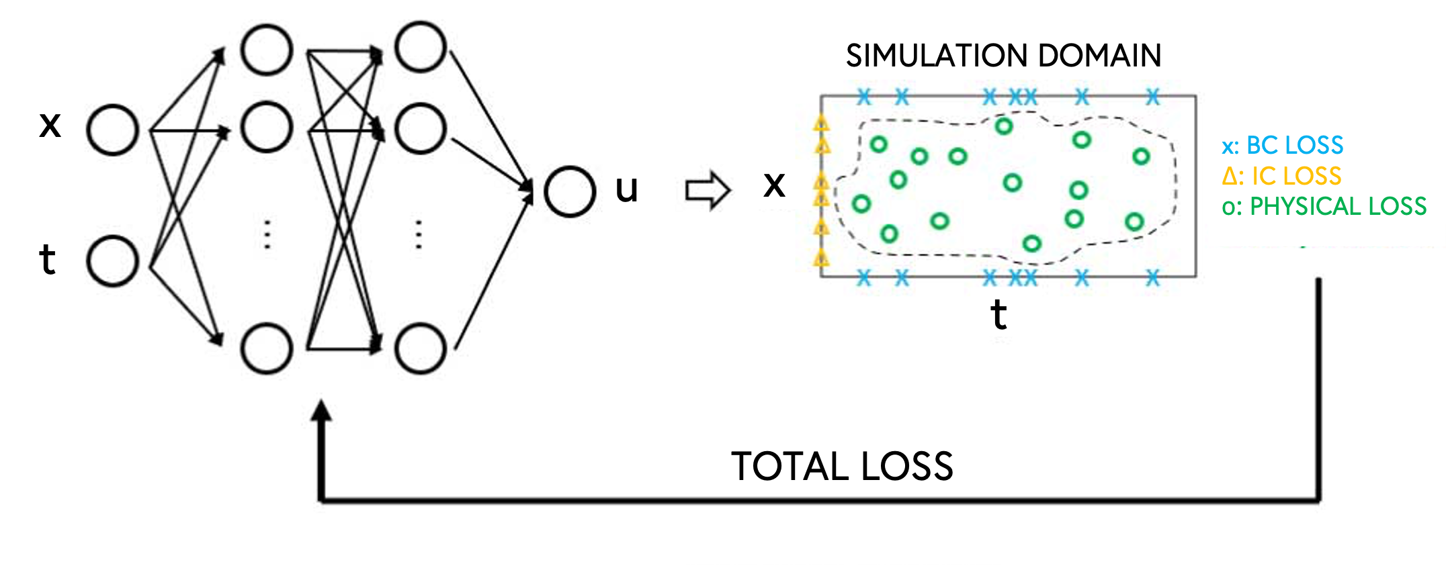
PINNS
What are PINNS:
Neural networks that incorporate physical laws into training
Key insight:
Combine data-driven learning with physics constraints = "Learning while respecting the laws of physics“
Traditional numerical methods limitations:
Computational cost
Mesh requirements
Limited data handling
Curse of dimensionality
Limited generalisation

Slide 4
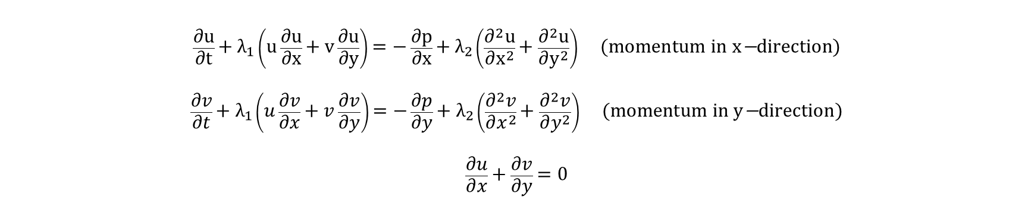
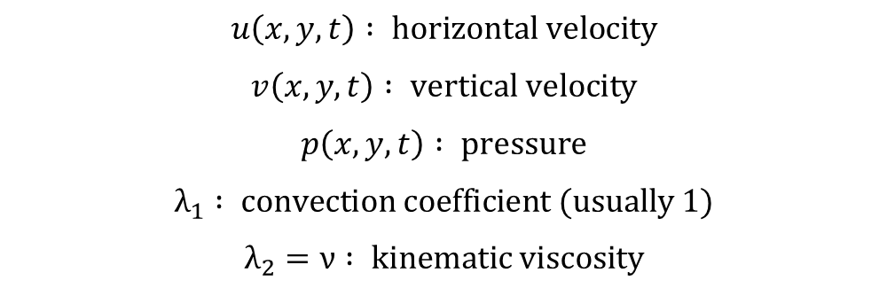
NAVIER-STOKES EQUATIONS
$$u\left(x,y,t\right) : \text{horizontal} \text{velocity}$$
$$v\left(x,y,t\right) : \text{vertical} \text{velocity}$$
$$p\left(x,y,t\right) : \text{pressure}$$
$$λ_{1} : \text{convection} \text{coefficient}\text{ (}\text{usually}\text{ 1)}$$
$$λ_{2}=ν : \text{kinematic} \text{viscosity}$$
Foundation of fluid dynamics
Partial differential equations governing fluid motion
Challenging to solve numerically
$$\frac{∂u}{∂t}+λ_{1}\left(u\frac{∂u}{∂x}+v\frac{∂u}{∂y}\right)=−\frac{∂p}{∂x}+λ_{2}\left(\frac{∂^{2}u}{∂x^{2}}+\frac{∂^{2}u}{∂y^{2}}\right) \text{(}\text{momentum} \text{in} \text{x}\text{−}\text{direction}\text{)}$$
$$\frac{∂v}{∂t}+λ_{1}\left(u\frac{∂v}{∂x}+v\frac{∂v}{∂y}\right)=−\frac{∂p}{∂y}+λ_{2}\left(\frac{∂^{2}v}{∂x^{2}}+\frac{∂^{2}v}{∂y^{2}}\right) \text{(}\text{momentum} \text{in} \text{y}\text{−}\text{direction}\text{)}$$
$$\frac{∂u}{∂x}+\frac{∂v}{∂y}=0$$
SE03
04

Slide 5
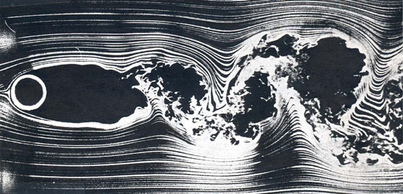
Wake-cylinder DATA
Domain: [-15, 25] × [-8, 8]
Reynolds number: 100
Visualization of the flow simulation
What we're predicting: λ₁, λ₂, and pressure field p

Slide 6
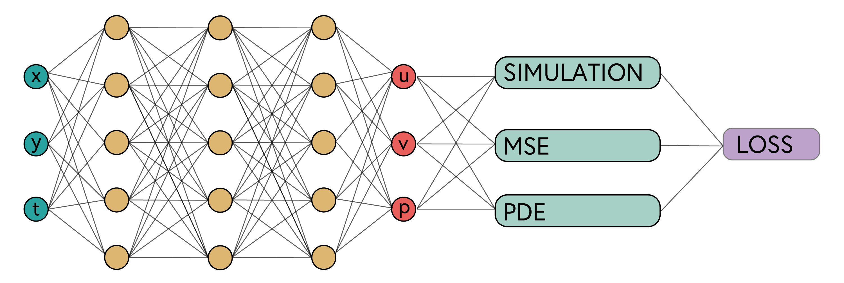
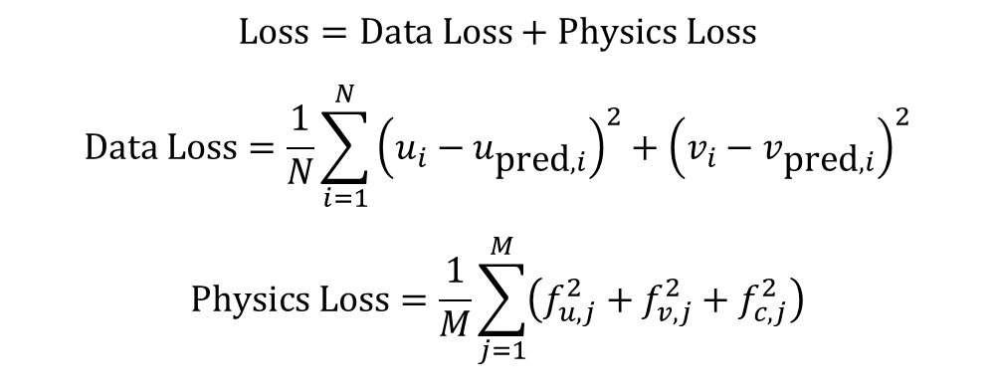
PINN ARCHITECTURE
$$\text{Loss}=\text{Data} \text{Loss}+\text{Physics} \text{Loss}$$
$$\text{Data} \text{Loss}=\frac{1}{N}\sum_{i=1}^{N}{{\left(u_{i}−u_{\text{pred},i}\right)}^{2}}+{\left(v_{i}−v_{\text{pred},i}\right)}^{2}$$
$$\text{Physics} \text{Loss}=\frac{1}{M}\sum_{j=1}^{M}{\left(f_{u,j}^{2}+f_{v,j}^{2}+f_{c,j}^{2}\right)}$$
SE03
06

Slide 7
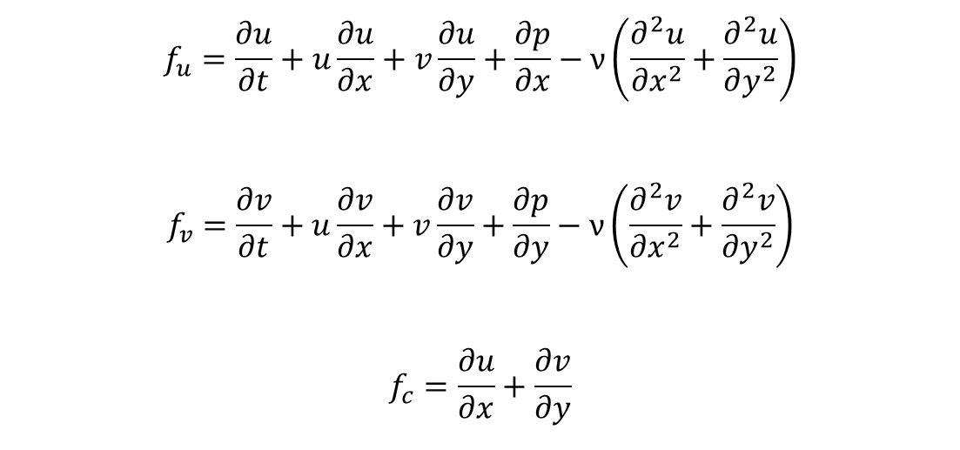
physics-constraints
$$f_{u}=\frac{∂u}{∂t}+u\frac{∂u}{∂x}+v\frac{∂u}{∂y}+\frac{∂p}{∂x}−ν\left(\frac{∂^{2}u}{∂x^{2}}+\frac{∂^{2}u}{∂y^{2}}\right)$$
$$f_{v}=\frac{∂v}{∂t}+u\frac{∂v}{∂x}+v\frac{∂v}{∂y}+\frac{∂p}{∂y}−ν\left(\frac{∂^{2}v}{∂x^{2}}+\frac{∂^{2}v}{∂y^{2}}\right)$$
$$f_{c}=\frac{∂u}{∂x}+\frac{∂v}{∂y}$$
SE03
07

Slide 8
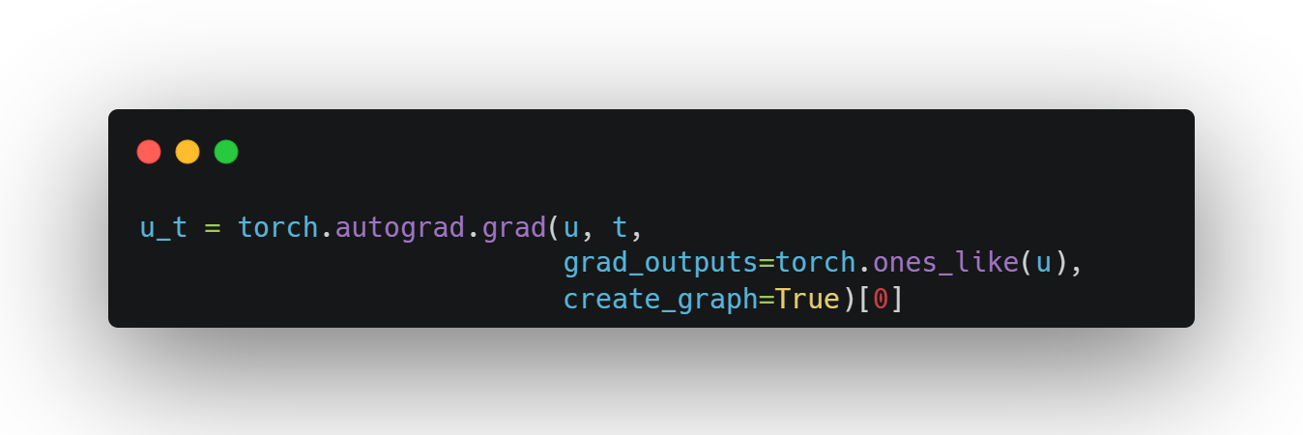
AUTOGRAD
DIFFERENTIATION
Parameter | Purpose | Description
`u` | Target tensor | The output we want to differentiate
`t` | Source tensor | The variable we're differentiating with respect to
`grad_outputs` | Scaling factor | Usually ones, for direct gradient computation
`create_graph` | Enable higher derivatives | Needed for second derivatives
SE03
08

Slide 9
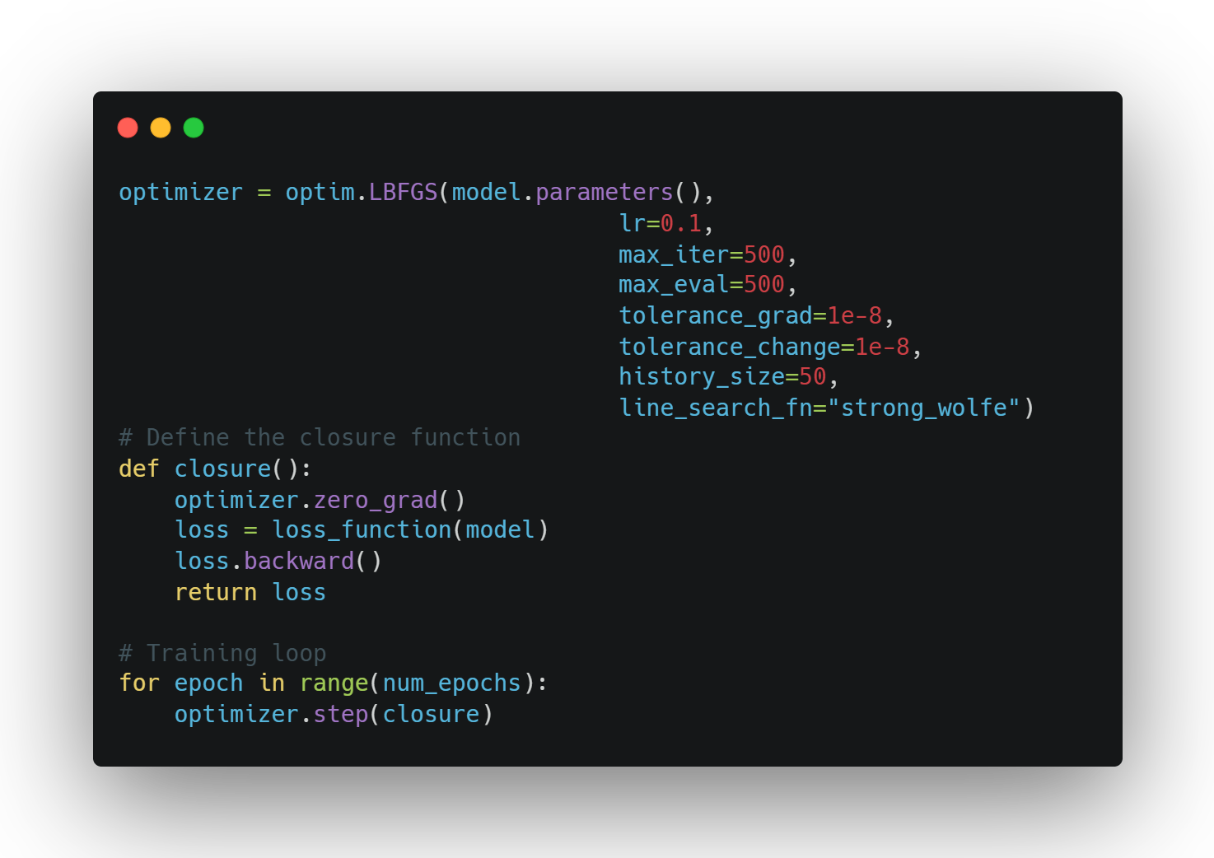
Training process
Two-phase optimization strategy
Phase 1: Adam optimizer (warm-up)
Phase 2: L-BFGS optimizer (fine-tuning)
tolerance_grad
Stops optimization when the maximum element in the gradient vector falls below this threshold
Smaller values → More precise solutions
tolerance_change
Terminates when relative change in function value is below threshold
Prevents wasting computation when progress stalls
history_size
Number of past iterations stored to approximate Hessian matrix
Larger values → Better curvature information → More accurate steps
SE03
09

Slide 10
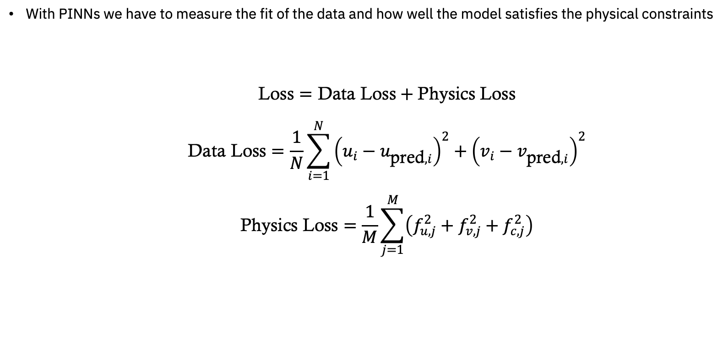
Loss function
With PINNs we have to measure the fit of the data and how well the model satisfies the physical constraints
$$\text{Loss}=\text{Data} \text{Loss}+\text{Physics} \text{Loss}$$
$$\text{Data} \text{Loss}=\frac{1}{N}\sum_{i=1}^{N}{{\left(u_{i}−u_{\text{pred},i}\right)}^{2}}+{\left(v_{i}−v_{\text{pred},i}\right)}^{2}$$
$$\text{Physics} \text{Loss}=\frac{1}{M}\sum_{j=1}^{M}{\left(f_{u,j}^{2}+f_{v,j}^{2}+f_{c,j}^{2}\right)}$$
SE03
10

Slide 11
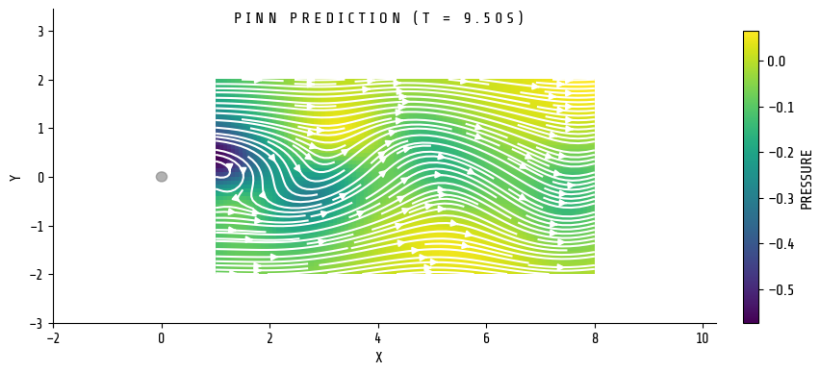
Advantages and limitations
Working with limited data (only 1% training data)
No pressure data needed for training
Physics-consistent prediction
Computational cost of training
Handling of boundary conditions
Scaling to more complex geometries

